Slide 1
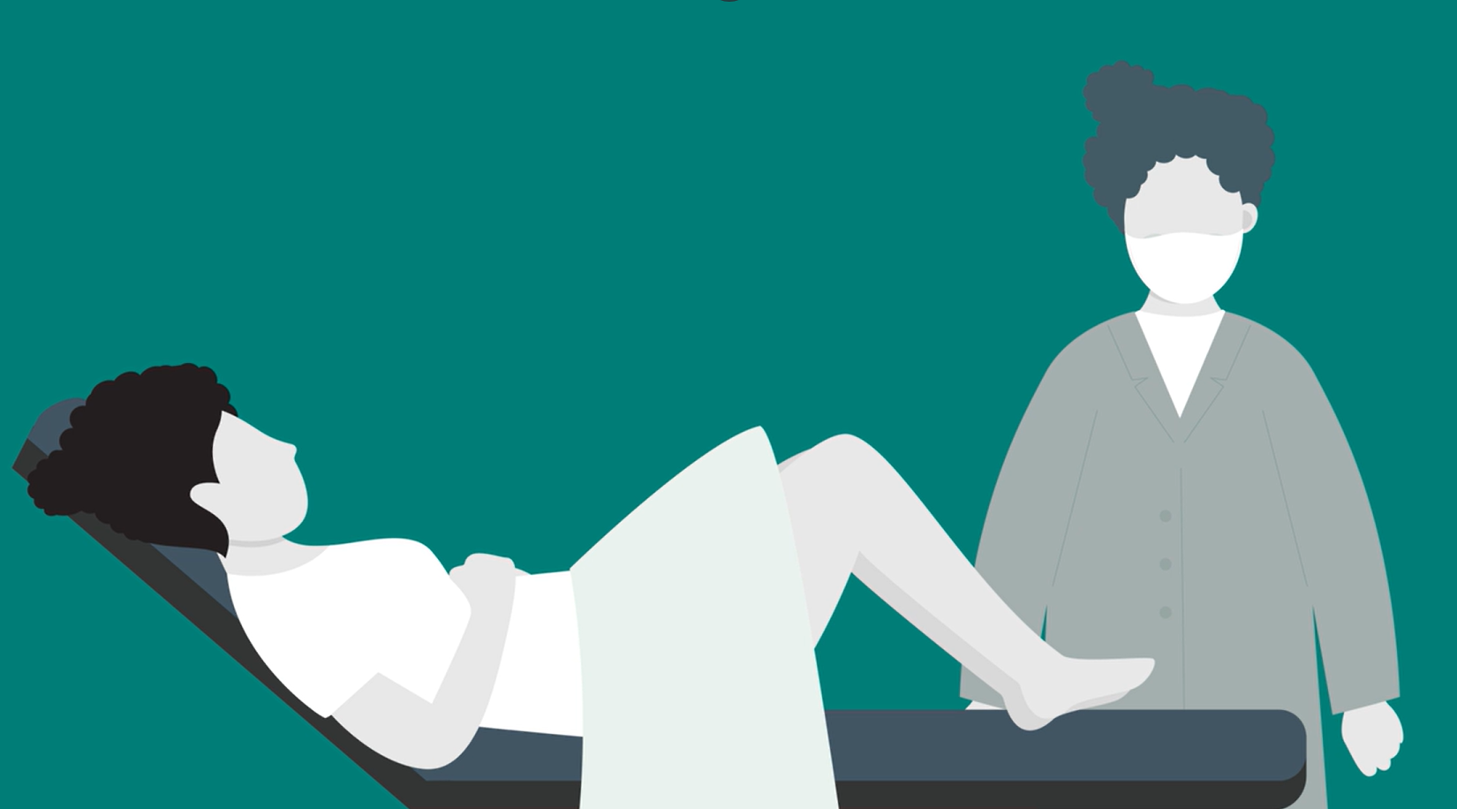
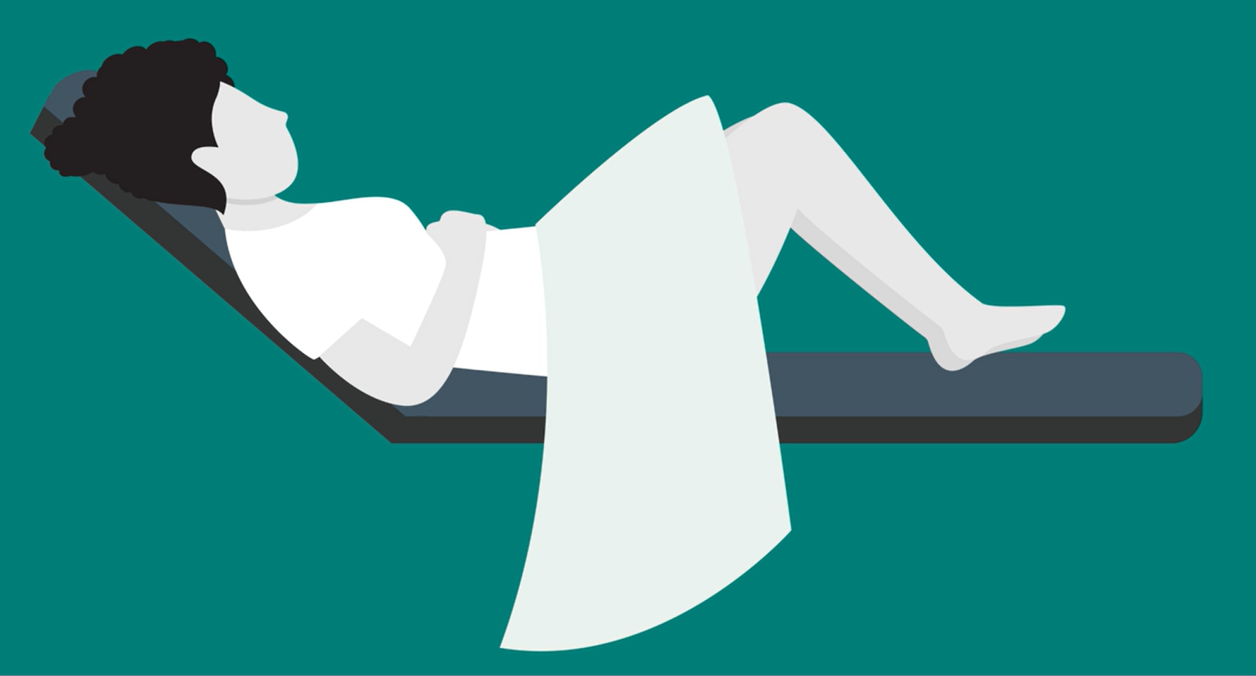
My Smear Test Story
My name is: …………………….........
I am …………………………years old
1
I am between 25 and 64 years old, so it is time to go to the doctor to have my smear test.
2
The test happens inside my vagina.
3
The test checks that I won’t develop cancer.

Slide 2
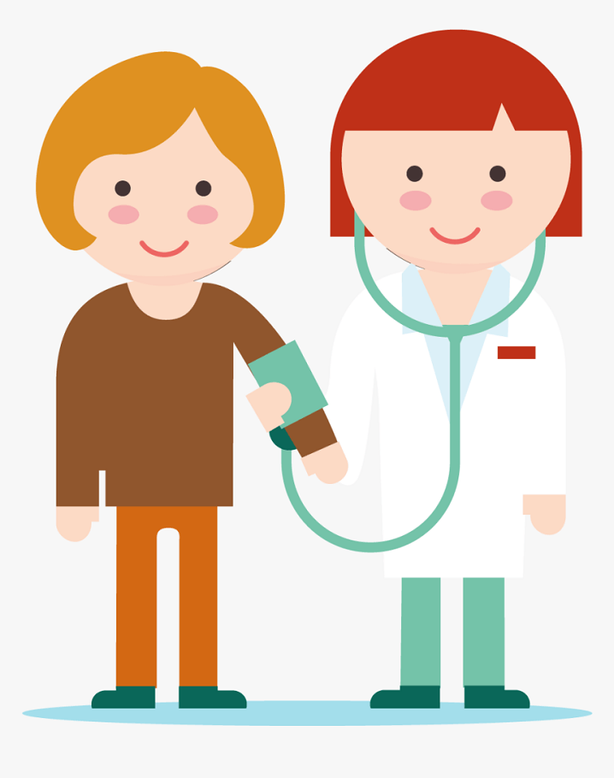
My Smear Test Story
4
My test will be with a female doctor
5
A soft brush will go into my vagina to collect a sample.
6
Most test result are normal and healthy!

Slide 3
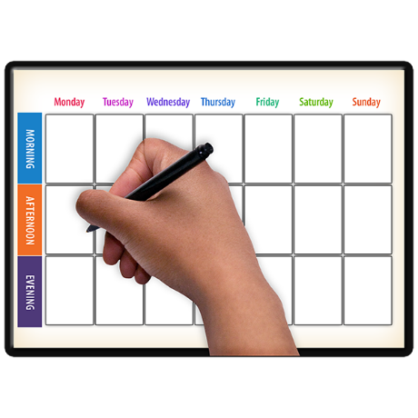
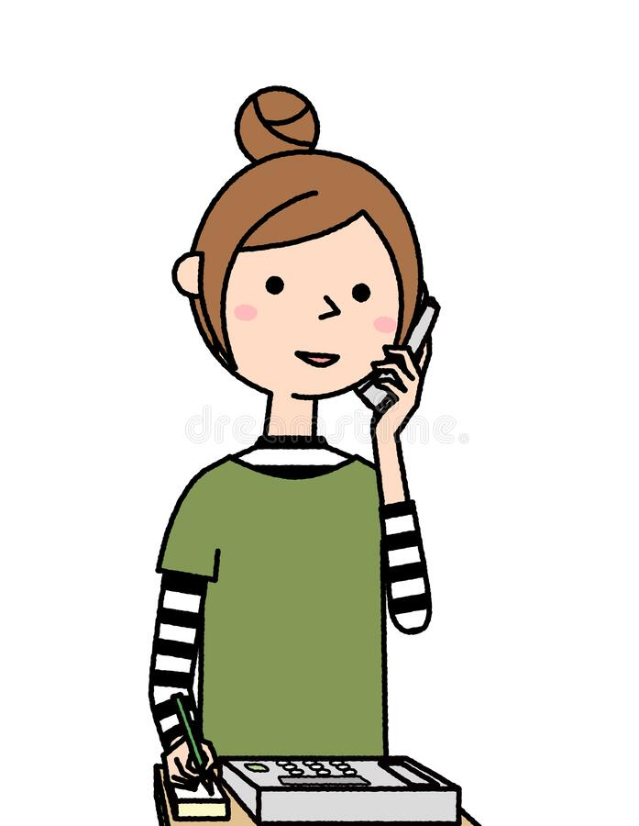
My Smear Test Story
7
My doctor gives me a date and a time for my test.
8
I make sure I am not on my period.
9
I can call the doctor to change the appointment.
[Contact number]

Slide 4
My Smear Test Story
10
10
I make sure I do not use any creams on my vagina in the 2 days before my test.
11
I can bring a relative, carer or friend.
12
To make the test easy, I wear a dress or a skirt.
I may see a spot of blood after my test, but this is perfectly normal.

Slide 5
My Smear Test Story
The test is very safe.
We recommend that you get tested, it could save your life
My test will be:
Date ………………………
Time ………………………
If I Need Help
If I need help to find my doctor or change my appointment, I can call the disability team:
[number]
If I Want More Information
I can ask the disability team to send me a text with links to a longer Easy Read leaflet or a video I can watch that tells me more about the smear test.

