Slide 1
NHS Screening Programmes Introduction NHSE/I Public Health Programmes Team
Feb 2022
Notes:
This introduction to NHS screening programmes training slides set is part of a series. This slide set will look at what is screening and some of the NHS screening programmes we have in England for cancer and non cancer. The slides are a collaboration between Cancer Research UK and NHSEI Public Health Programmes Team.

Slide 2
Early Diagnosis & Survival
In a nutshell…….
“Cancer that’s diagnosed at an early stage, before it’s had the chance to get too big or spread is more likely to be treated successfully. If the cancer has spread, treatment becomes more difficult, and generally a person’s chances of surviving are much lower”
Notes:
Early diagnosis is key to survival from disease and the prevention of harm.

Slide 3
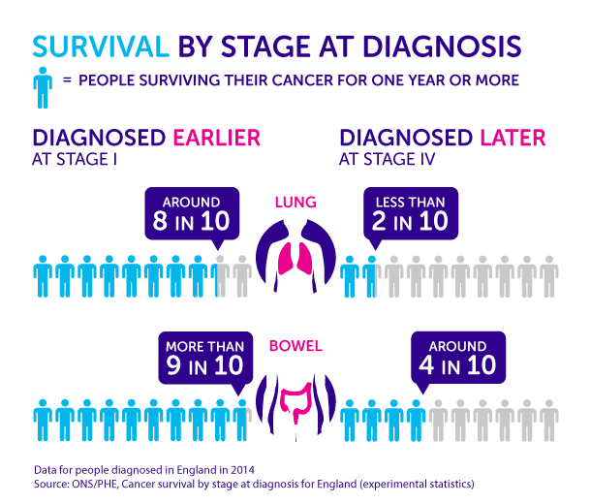
Early Diagnosis & Survival
DIAGNOSING CANCERS EARLY COULD MAKE A REAL DIFFERENCE TO SURVIVAL
Notes:
Cancers are given a stage 1 to 4, 1 early and 4 is late.

Slide 4
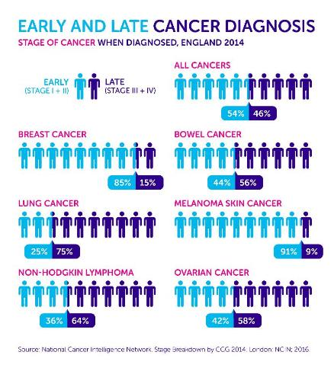
Early Diagnosis & Survival
ONLY 54% OF CANCERS ARE DIAGNOSED AT AN EARLY STAGE
THERE IS VARIATION IN STAGE DISTRIBUTION BY CANCER TYPE

Slide 5
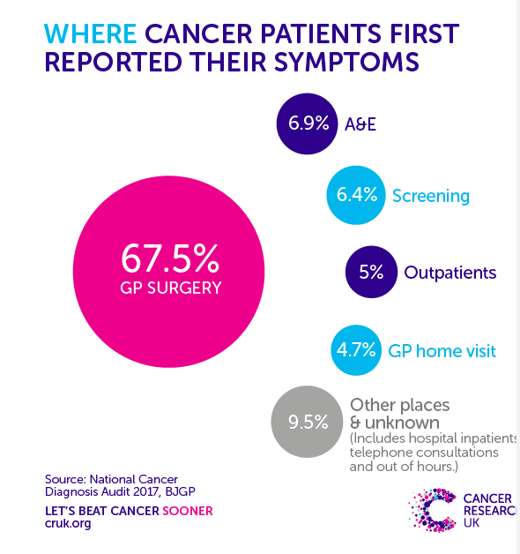
Routes to Diagnosis
Most cancer patients present to a GP first (GP surgery and GP home visit)

Slide 6
What is Screening?
Screening is where groups of apparently healthy individuals are invited to undertake a test
Screening is a way of detecting the early signs of disease – it is meant for people without any symptoms
The primary purpose is to reduce the risk of a poor health outcome by either starting treatment without delay or being given information about risk that is deemed valuable for the individual even if the risk cannot be changed
Notes:
Aim of the slide: To explain what we mean by screening
Key points:
Cancer screening is for people without symptoms
It is meant for apparently healthy people, and aims to detect cancer, or potential pre-cancer, before any cancer symptoms appear
Adaptations: You may want to just use this slide for a non-clinical audience
Extra information:
If people have symptoms they should see their GP straight away, even if they have recently had screening or have a screening appointment coming up. They shouldn’t wait for the next screening round.

Slide 7
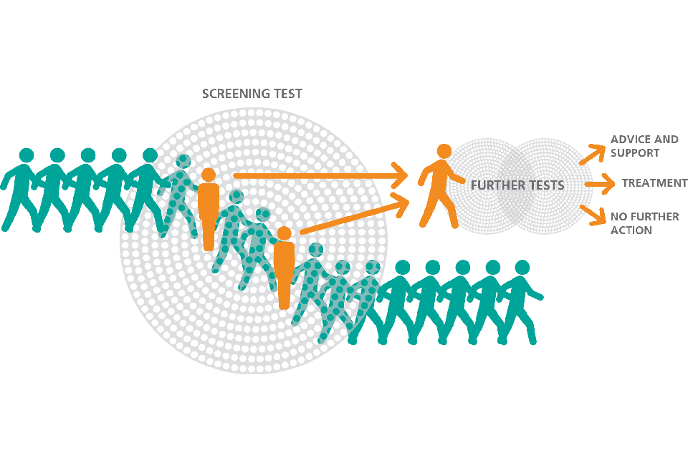
What is Screening?
It targets a specific population or group of people
It is like a filter or sieve
Most people are unlikely to have the condition and will pass through the filter (screening test) GREEN people
People whose results suggest they are more likely to have the condition are caught in the filter - they need further tests to determine if they really do have the condition ORANGE people
Notes:
Aim of slide: To explain how screening works
Key points:
Screening is like a filter:
Most people will pass through with nothing showing up
People who might have something wrong are caught in the filter and will need further tests
Adaptations:
You might want to only include this slide for non-clinical audiences (eg, receptionists and practice cancer champions)
Extra information:
Screening tests do not diagnose cancer, they only identify people that need further tests. They do this by looking for biological indications that someone may have a condition at that time – eg blood in poo, abnormal cells.
Cancer screening doesn’t identify people who may have a higher risk for another reason, such as a faulty gene, family history, or exposure to a risk factor such as smoking.
A normal test result doesn’t mean someone is at low/no risk of developing cancer in the future.

Slide 8
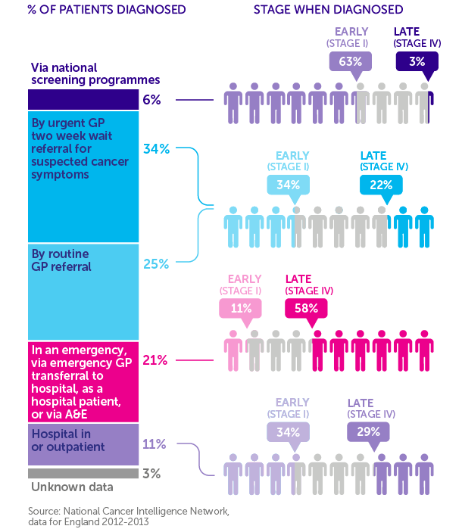
Why is Screening Important?
Screening reduces the number of people dying from cancer by:
Detecting cancer early
63% of cancers detected through screening are at an early stage (stage I)
Preventing cancer Cervical screening
can prevent cancer
Notes:
Aim of this slide: To explain why we encourage people to participate in the screening programmes
Key points:
Screening is a great way to spot cancer when it is at an early stage (63% of cancers detected through screening are stage I)
This early diagnosis, coupled with prevention of cancers developing in the first place (in bowel scope screening and cervical screening) is how screening saves lives.
Adaptations
The infographic uses data from England, but we’d expect to see a similar picture for other UK countries
Extra information
Be aware that you may get questioned about overdiagnosis at this point. For example, lots of early stage breast cancers are picked up by screening that didn’t need to be treated in the first place. If this is raised, acknowledge that this is an issue with screening and stress that that is why it is important to give people information on the harms as well as the benefits so they can make an informed choice. Also explain you will cover this in more depth later on in the presentation
These statistics come from Routes to diagnosis analysis from NCIN (now known as NCRAS).
The analysis looked at ten cancer types: bladder, breast, bowel, kidney, lung, melanoma, non-Hodgkin lymphoma, ovarian, prostate and uterine cancers, between 2012 and 2013.
Of the total 574,500 cases analysed, screening picked up the highest proportion of early stage cancers
We blogged about the findings here: http://scienceblog.cancerresearchuk.org/2016/01/22/improving-cancer-survival-by-understanding-how-patients-are-diagnosed/
Here is the NCRAS Routes to diagnosis webpage: http://www.ncin.org.uk/publications/routes_to_diagnosis
You can download this infographic from the asset hub: https://theassethub.cancerresearchuk.org/media/?mediaId=849D9334-05FF-4FD5-A5B78E58492CB093
This infographic will be updated with more recent data in summer 2017

Slide 9
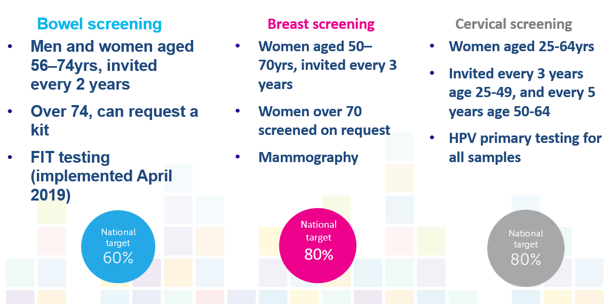
Cancer Screening Programmes ENGLAND
Notes:
Aim of slide: To explain how screening works
Key points:
Screening is like a filter:
Most people will pass through with nothing showing up
People who might have something wrong are caught in the filter and will need further tests
Adaptations:
You might want to only include this slide for non-clinical audiences (eg, receptionists and practice cancer champions)
Extra information:
Screening tests do not diagnose cancer, they only identify people that need further tests. They do this by looking for biological indications that someone may have a condition at that time – eg blood in poo, abnormal cells.
Cancer screening doesn’t identify people who may have a higher risk for another reason, such as a faulty gene, family history, or exposure to a risk factor such as smoking.
A normal test result doesn’t mean someone is at low/no risk of developing cancer in the future.

Slide 10
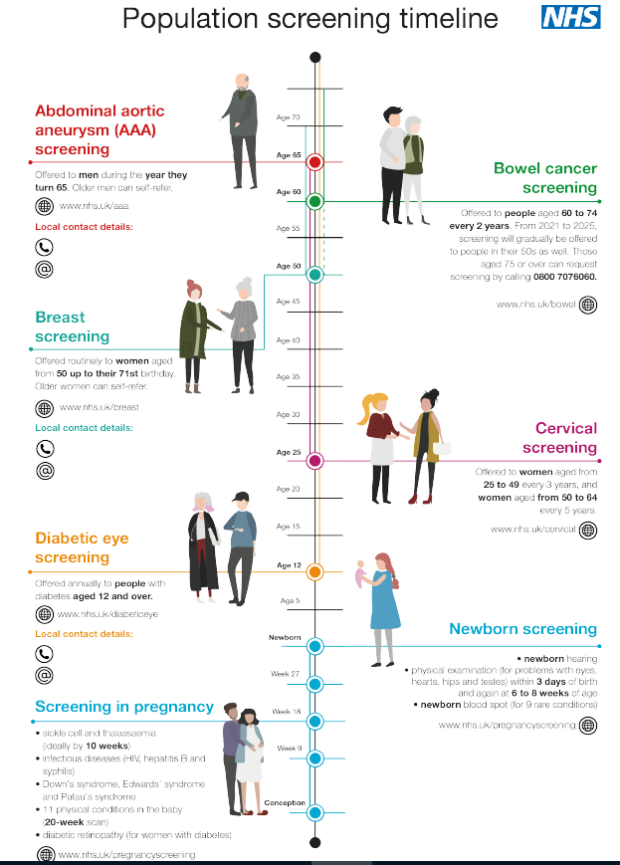
Screening Timeline
Links to PHE screening animations for both Females and Males
Female lifetime screening pathway animation
Male lifetime screening pathway animation
Posters available at
https://www.gov.uk/guidance/nhs-population-screening-explained
Notes:
Aim of the slide: To explain what we mean by screening
Key points:
Cancer screening is for people without symptoms
It is meant for apparently healthy people, and aims to detect cancer, or potential pre-cancer, before any cancer symptoms appear
Adaptations: You may want to just use this slide for a non-clinical audience
Extra information:
If people have symptoms they should see their GP straight away, even if they have recently had screening or have a screening appointment coming up. They shouldn’t wait for the next screening round.

