Slide 1
BREAST SCREENING
Notes:
Sharon

Slide 2
Breast Cancer Facts
Breast cancer is the most common cancer in women in the UK – around 150 cases are diagnosed every day
Almost 11,400 deaths per year
70% of women survive breast cancer for 10 or more years
27% of breast cancer cases in the UK are linked to major lifestyle and other risk factors
Notes:
Aim of this slide: To explain what a colonoscopy is and what the outcomes can be
Key points:
Colonoscopy is usually recommended for people with an abnormal FOBt result
Before a colonoscopy patients will have an appointment with a specialist nurse to talk through the procedure and determine whether they are fit to take part
The colonoscopy usually takes place in the endoscopy unit of a hospital
During a colonoscopy a flexible tube with a camera is inserted into the bowel
The endoscopist will let the person know if they had to take any biopsies or remove polyps.
If biopsies are taken, they may need to wait up to 3 weeks to get the results.
Patients will be sent a letter explaining the results of their colonoscopy and their GP will also get the results.
If cancer is found, the patient will be given an appointment to see a specialist as soon as possible
For every 100 people having a colonoscopy:
50 have neither cancer nor polyps
40 have polyps
10 have cancer
Adaptations
You may feel this slide is less relevant for certain audiences eg. pharmacists.
Extra information:
The statistics on the slide are quoted in the English and Scottish official leaflets. They are from England and come from the Logan et al paper, published in 2012 http://gut.bmj.com/content/61/10/1439 )
The test itself takes about 30 minutes, but the whole appointment can take up to 4 hours.
People can be sedated if they wish or have painkillers
There is a CRUK video ‘having a colonoscopy’, available here: https://www.youtube.com/watch?v=Q7FWQ7cy8kQ

Slide 3
Breast Cancer
Common Symptoms
A change in the size, shape or feel of a breast
A new lump or thickening in a breast or armpit
Skin changes such as puckering, dimpling, a rash or redness of the skin
Fluid leaking from a nipple in a woman who isn't pregnant or breastfeeding
Changes in the position of a nipple
Pain in a breast
Women who notice any unusual or persistent changes should see their GP straight away – they shouldn’t wait to be screened
Notes:
Aim of this slide: To explain what a colonoscopy is and what the outcomes can be
Key points:
Colonoscopy is usually recommended for people with an abnormal FOBt result
Before a colonoscopy patients will have an appointment with a specialist nurse to talk through the procedure and determine whether they are fit to take part
The colonoscopy usually takes place in the endoscopy unit of a hospital
During a colonoscopy a flexible tube with a camera is inserted into the bowel
The endoscopist will let the person know if they had to take any biopsies or remove polyps.
If biopsies are taken, they may need to wait up to 3 weeks to get the results.
Patients will be sent a letter explaining the results of their colonoscopy and their GP will also get the results.
If cancer is found, the patient will be given an appointment to see a specialist as soon as possible
For every 100 people having a colonoscopy:
50 have neither cancer nor polyps
40 have polyps
10 have cancer
Adaptations
You may feel this slide is less relevant for certain audiences eg. pharmacists.
Extra information:
The statistics on the slide are quoted in the English and Scottish official leaflets. They are from England and come from the Logan et al paper, published in 2012 http://gut.bmj.com/content/61/10/1439 )
The test itself takes about 30 minutes, but the whole appointment can take up to 4 hours.
People can be sedated if they wish or have painkillers
There is a CRUK video ‘having a colonoscopy’, available here: https://www.youtube.com/watch?v=Q7FWQ7cy8kQ

Slide 4
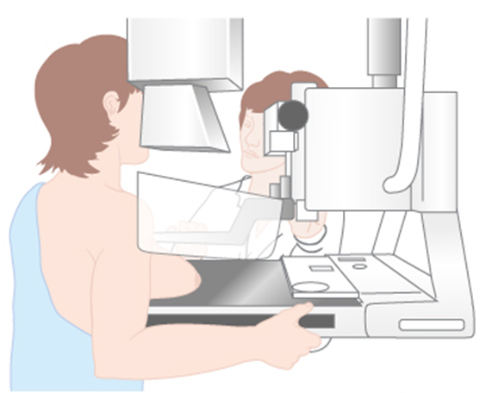
Breast Screening
Mammography
For women aged between 50 and 70 years, who are registered with a GP
Test is a mammogram – 2 x-rays of each breast
Carried out at special clinics or mobile breast screening units
Self-referral over 70
Notes:
Aim of this slide: To explain what a colonoscopy is and what the outcomes can be
Key points:
Colonoscopy is usually recommended for people with an abnormal FOBt result
Before a colonoscopy patients will have an appointment with a specialist nurse to talk through the procedure and determine whether they are fit to take part
The colonoscopy usually takes place in the endoscopy unit of a hospital
During a colonoscopy a flexible tube with a camera is inserted into the bowel
The endoscopist will let the person know if they had to take any biopsies or remove polyps.
If biopsies are taken, they may need to wait up to 3 weeks to get the results.
Patients will be sent a letter explaining the results of their colonoscopy and their GP will also get the results.
If cancer is found, the patient will be given an appointment to see a specialist as soon as possible
For every 100 people having a colonoscopy:
50 have neither cancer nor polyps
40 have polyps
10 have cancer
Adaptations
You may feel this slide is less relevant for certain audiences eg. pharmacists.
Extra information:
The statistics on the slide are quoted in the English and Scottish official leaflets. They are from England and come from the Logan et al paper, published in 2012 http://gut.bmj.com/content/61/10/1439 )
The test itself takes about 30 minutes, but the whole appointment can take up to 4 hours.
People can be sedated if they wish or have painkillers
There is a CRUK video ‘having a colonoscopy’, available here: https://www.youtube.com/watch?v=Q7FWQ7cy8kQ

Slide 5
Know Your Lemons
Notes:
Aim of this slide: To explain what a colonoscopy is and what the outcomes can be
Key points:
Colonoscopy is usually recommended for people with an abnormal FOBt result
Before a colonoscopy patients will have an appointment with a specialist nurse to talk through the procedure and determine whether they are fit to take part
The colonoscopy usually takes place in the endoscopy unit of a hospital
During a colonoscopy a flexible tube with a camera is inserted into the bowel
The endoscopist will let the person know if they had to take any biopsies or remove polyps.
If biopsies are taken, they may need to wait up to 3 weeks to get the results.
Patients will be sent a letter explaining the results of their colonoscopy and their GP will also get the results.
If cancer is found, the patient will be given an appointment to see a specialist as soon as possible
For every 100 people having a colonoscopy:
50 have neither cancer nor polyps
40 have polyps
10 have cancer
Adaptations
You may feel this slide is less relevant for certain audiences eg. pharmacists.
Extra information:
The statistics on the slide are quoted in the English and Scottish official leaflets. They are from England and come from the Logan et al paper, published in 2012 http://gut.bmj.com/content/61/10/1439 )
The test itself takes about 30 minutes, but the whole appointment can take up to 4 hours.
People can be sedated if they wish or have painkillers
There is a CRUK video ‘having a colonoscopy’, available here: https://www.youtube.com/watch?v=Q7FWQ7cy8kQ

