Slide 1
CERVICAL SCREENING
Notes:
Sharon

Slide 2
Cervical Cancer Facts
In women, cervical cancer is the 13th most common cancer
Around 900 deaths a year
63% of women survive cervical cancer for 10 years or more
HPV infection is the main risk factor for cervical cancer
Notes:
Aim of this slide: To give the audience some facts on cervical cancer
Key points
Cervical cancer is the 13th most common cancer in women
There are over 3000 new cases in the UK each year and around 900 deaths (data from 2014, is for all women not just those of screening age)
63% of women survive cervical cancer for 10 years or more (2010-11, England and Wales)
Cervical cancer is one of the most preventable cancer types. Screening and vaccination can help prevent the disease.
HPV infection is the main risk factor
Extra information
Across the UK, girls aged between 12 and 13 are offered a vaccination against the human papillomavirus (HPV). The vaccine is very effective at preventing infection with the 2 types of HPV that cause about 7 in 10 cervical cancers (plus the 2 types associated with most cases of genital warts).
HPV infection is the main risk factor for cervical cancer, linked to nearly 100% of cervical cancer cases in the UK.
Some other factors may relate to cervical cancer risk partly because they are related to HPV. Smoking, human immunodeficiency virus (HIV), and oral contraceptives are associated with cervical cancer
When diagnosed at its earliest stage (stage I), 96% of women with cervical cancer will survive their disease for five years or more, compared with 5% of women when diagnosed at the latest stage (stage IV).
Statistics come from CRUK webpages: http://www.cancerresearchuk.org/health-professional/cancer-statistics/statistics-by-cancer-type/cervical-cancer

Slide 3
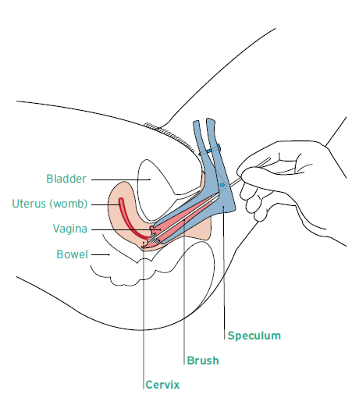
Cervical Screening
CERVICAL SCREENING AIMS TO PREVENT CANCER
It is NOT a test to find cancer. It is a test to detect changes to the cells of the cervix that may develop into cancer in the future
Women from 25-64, who are registered with a GP are invited for cervical screening
Women aged 25-49 are invited every 3 years. After that, women are invited every 5 years until the age of 64
The test collects samples of cells from the cervix
YouTube Video: https://youtu.be/QjuEYqQvb0E
Notes:
Aim of this slide: To give more details of how cervical screening works - Video: https://youtu.be/QjuEYqQvb0E
Key points
The test looks for changes to cervical cells, which could turn into cancer in the future.
During the test women are instructed to take off their underwear and lie on their back with their knees drawn up and spread apart.
A doctor or nurse inserts an instrument (a speculum) to open the woman's vagina so that they can see the cervix.
They then use a brush to collect samples of cells from the cervix
It is a test for women who don’t have symptoms
All women aged 25-64 are eligible, if registered with a GP
Extra information
Screening is advised for all women with a cervix regardless of sexual orientation.
Screening can still be of value for women who have never been sexually active although the risk of cervical cancer is low in this group.
Cervical screening is important for transgender men if they haven’t had a full hysterectomy. The GP can arrange for screening self-referral, as people who are registered with the GP as male won’t be invited to the programme automatically
For women who have had a partial hysterectomy and the cervix is still in situ cervical screening is still important
Women may have a very similar procedure if they have gynaecological symptoms that need investigating, which may lead to confusion among patients for eg women asking for a ‘smear’ because of symptoms, so it may be helpful to get more context when women are making appointments – eg were they prompted by a letter or do they have symptoms.
Why is the age range not below 25? In 2003, the Advisory Committee on Cervical Screening (ACCS), reviewed the evidence and concluded that the harms of screening for those aged 20 – 25 outweighed the benefits and they recommended raising the lower age limit to 25. A study by Landy et al in the British Journal of Cancer in 2014 found that between 300 and 900 young women would have unnecessary treatment in order to prevent one case of invasive cancer. Link to paper: http://www.nature.com/bjc/journal/v110/n7/full/bjc201465a.html
There is no self-referral option for women above the screening age
Difficulty in obtaining cervical screens in older women
There may be a difficulty in getting a good quality cervical screen in a post-menopausal woman due to vaginal atrophy (where vaginal and cervical mucosa become thinner and drier due to lack of oestrogen). In this case a GP may advise a low dose oestrogen cream to be used internally for a period of time (usually 6-12 weeks) prior to repeating a cervical smear if a result comes back inadequate.
It is also possible to refer a woman to a colposcopy clinic if the GP practice has repeated difficulty in performing the screen or getting an adequate sample in any woman.
If a patient is enquiring about the age range for screening this may mean they have symptoms they are worried about. In this circumstance its good to give them the information, but also remind them if they have any symptoms they are worried about they shouldn’t wait to be screened, they should make an appointment with their GP.

Slide 4
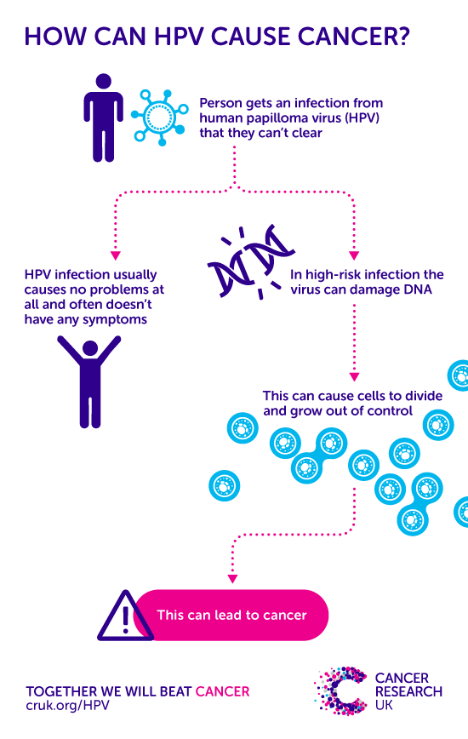
Human Papilloma Virus
(HPV)
HPV causes 99.8% of cervical cancer cases
HPV is a very common infection. Around 80% of people will come into contact with HPV during their lifetime. Most people will clear the infection naturally
Around 12 types of HPV are considered high risk for cancer of the cervix. Two of these types (HPV 16 and HPV 18) cause about 7 out of 10 (70%) cervical cancer cases
Notes:
Key points
Cervical cancer is one of the most preventable cancer types. Screening and vaccination can help prevent the disease.
HPV infection is the main risk factor – 99.8% of cervical cancer cases in the UK are caused by infections
The vaccination used in the UK is Guardasil.
Vaccination cover is estimated to last for 10 years/perhaps a bit longer
Extra Information:
Human papillomavirus (HPV) is a common virus transmitted through sexual contact. High risk sub-types of HPV (HR-HPV) are linked to the development of abnormal cells and can cause cervical cancer. HPV is a necessary cause of invasive cervical cancer.
Evidence shows HPV testing is a better way of identifying women at risk of cervical cancer than the cytology (smear) test that examines cells under a microscope.
From September 2018, HPV testing will be rolled out across the UK, becoming the primary screening test, and only HPV positive samples will be referred on for cytology.

Slide 5
HPV Vaccination
Vaccination
Since 2008, girls aged 11-13 have been offered a vaccination against the two most common ‘high-risk’ types of HPV (HPV 16 and 18)
Vaccinations for boys aged 11 to 13 started in September 2019
As the HPV vaccine does not protect against all types of high risk HPV, regular cervical screening remains important

