Slide 1
Abdominal Aortic Aneurysm AAA

Slide 2
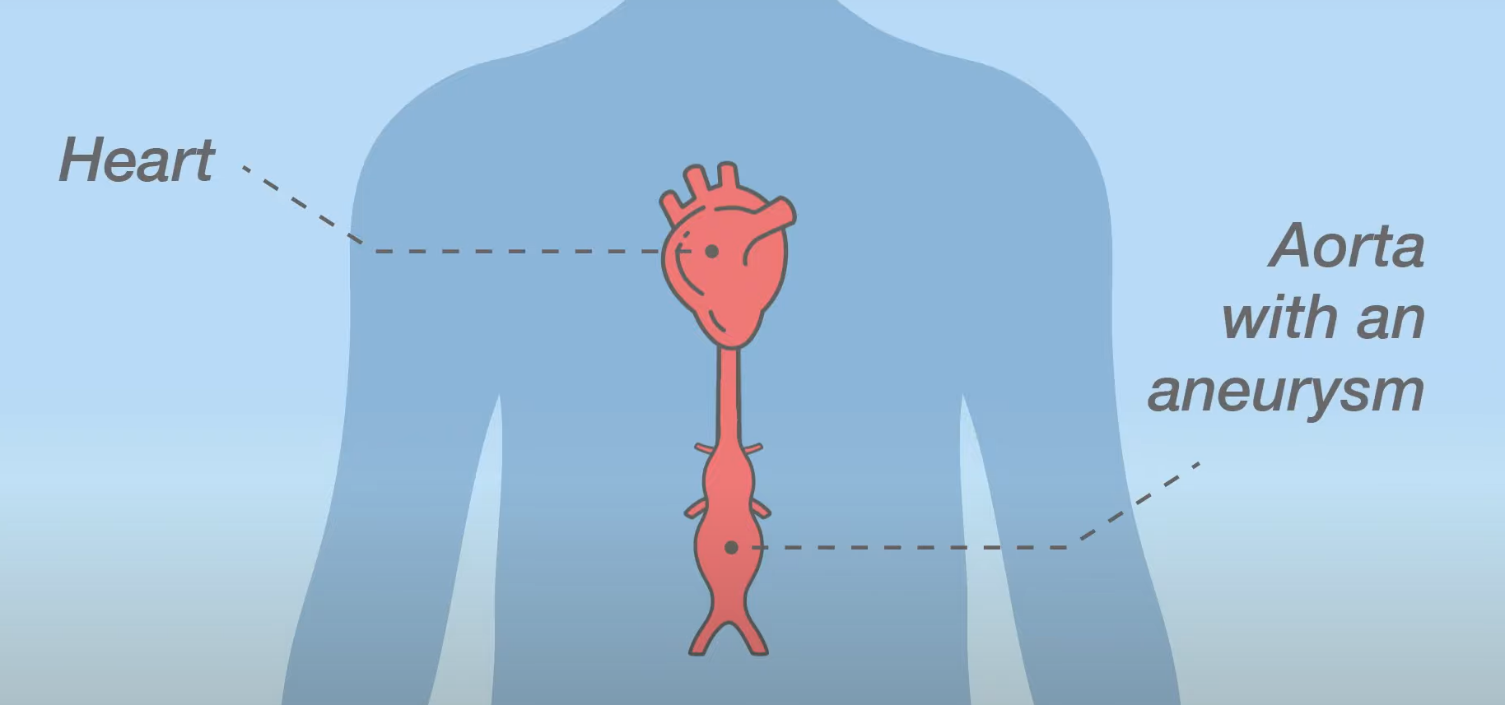
Abdominal Aortic Aneurysm Screening
AAA’s are far more common in men aged over 65 than in women and younger men. AAA screening is only currently offered to men. Invites are in their 65th year and are by postal letter. If an individual is unable to attend their appointment or wish to decline, they can do so by contacting the South Yorkshire and Bassetlaw AAA screening programme directly on Tel. 01709 649100. https://www.gov.uk/government/collections/aaa-screening-information-leaflets

Slide 3
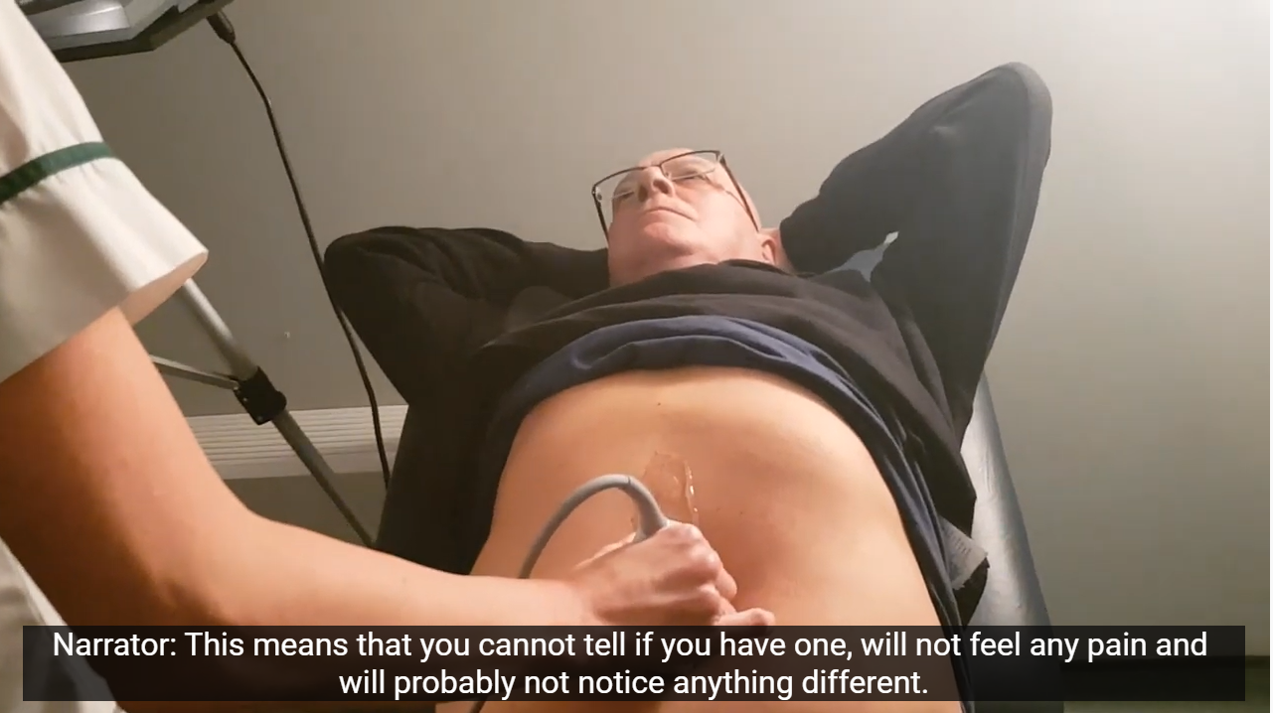
Abdominal Aortic Aneurysm Screening
The screening test is a simple, pain-free ultrasound scan of the abdomen that usually takes 10 -15 minutes. If no aneurysm is detected, the individual does not need to be screened again. Small to medium sized aneurysms will require monitoring at regular intervals, whereas surgery is the most common method used to repair large aneurysms.

Slide 4
Diabetic Eye Screening DES

Slide 5
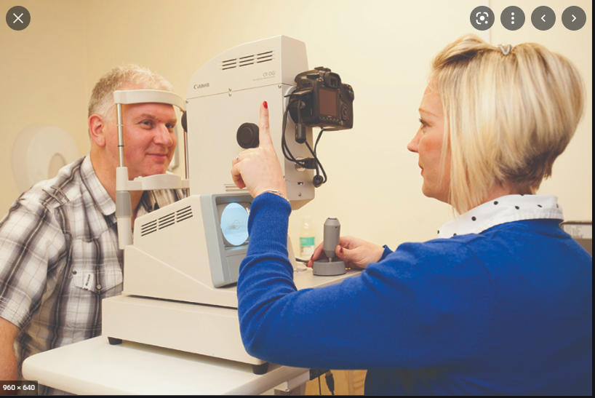
Diabetic Eye Screening
Diabetic eye screening is offered to anyone with diabetes who is 12 years old or over currently annually. The aim is to reduce the risk of sight loss by the prompt identification and effective treatment. https://www.gov.uk/government/collections/diabetic-eye-screening-information-leaflets

Slide 6
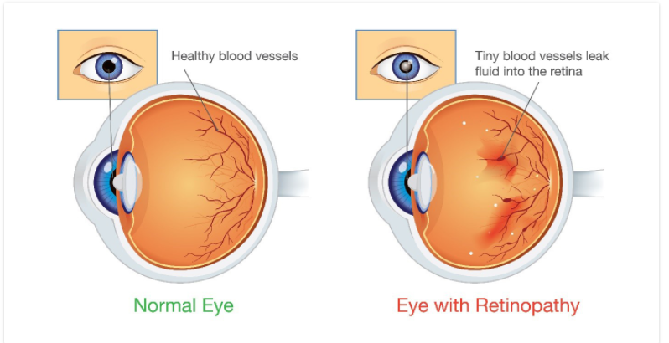
Diabetic Eye Screening
Diabetic retinopathy is a complication of diabetes, caused by high blood sugar levels damaging the back of the eye (retina). It can cause blindness if left undiagnosed and untreated. To minimise the risk of this happening, people with diabetes should ensure they control their blood sugar levels, and blood cholesterol and attend diabetic eye screening appointments.

