Slide 1
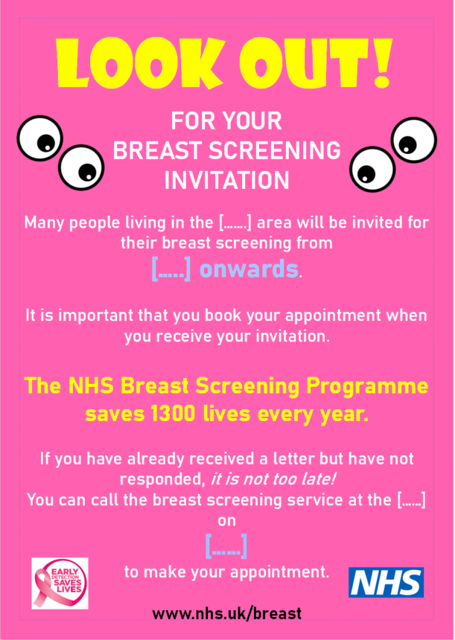
A Sheffield practice made a poster which they are willing for anyone to adopt.

