Slide 1
BOWEL SCREENING
Notes:
Fiona

Slide 2
Bowel Cancer Facts
Bowel cancer is the 4th most common cancer in the UK
Around 16,000 deaths a year
57% of people survive bowel cancer for 10 or more years
More than 50% of bowel cancer cases are linked to major lifestyle and other risk factors
Notes:
Aim of this slide:
To give some facts on bowel cancer
Key points:
Bowel cancer is the 4th most common cancer in the UK in 2014 (behind breast, prostate and lung cancer), there are around 40,000 new cases a year.
It is the second most common cause of cancer death in the UK in 2014 (behind lung cancer)
57% of people survive bowel cancer for 10 or more years (2010-11, England and Wales). The prognosis is better the earlier it is diagnosed
Around half of bowel cancer cases in the UK are linked to major lifestyle and other risk factors
Adaptations
Make sure you have the correct survival statistic for your country:
Scotland: 59.8% of people survive bowel cancer for 5 years (data from those diagnosed 2007-2011)
Northern Ireland: 56.3% of people survive bowel cancer for 5 years (data from those diagnosed 2005-2009)
Extra information
How can someone reduce their risk of bowel cancer? Things like a healthy diet and weight, drinking less alcohol, not smoking, being physically active and minimising exposure to radiation all reduce the risk of the disease. For more information on this see the prevention toolkit, which is saved here: G:\Local Engagement & Influencing\Health Professional Engagement\HPEF\6. Toolkit\4. Final Tools\Prevention
Bowel cancer is more common in White people than in Asian or Black people.
Bowel cancer deaths in England are more common in people living in the most deprived areas.
The facts for this slide come from the CRUK bowel cancer statistics webpage: http://www.cancerresearchuk.org/health-professional/cancer-statistics/statistics-by-cancer-type/bowel-cancer

Slide 3
Bowel Cancer
Common Symptoms
Notes:
Aim of this slide:
To give some facts on bowel cancer
Key points:
Bowel cancer is the 4th most common cancer in the UK in 2014 (behind breast, prostate and lung cancer), there are around 40,000 new cases a year.
It is the second most common cause of cancer death in the UK in 2014 (behind lung cancer)
57% of people survive bowel cancer for 10 or more years (2010-11, England and Wales). The prognosis is better the earlier it is diagnosed
Around half of bowel cancer cases in the UK are linked to major lifestyle and other risk factors
Adaptations
Make sure you have the correct survival statistic for your country:
Scotland: 59.8% of people survive bowel cancer for 5 years (data from those diagnosed 2007-2011)
Northern Ireland: 56.3% of people survive bowel cancer for 5 years (data from those diagnosed 2005-2009)
Extra information
How can someone reduce their risk of bowel cancer? Things like a healthy diet and weight, drinking less alcohol, not smoking, being physically active and minimising exposure to radiation all reduce the risk of the disease. For more information on this see the prevention toolkit, which is saved here: G:\Local Engagement & Influencing\Health Professional Engagement\HPEF\6. Toolkit\4. Final Tools\Prevention
Bowel cancer is more common in White people than in Asian or Black people.
Bowel cancer deaths in England are more common in people living in the most deprived areas.
The facts for this slide come from the CRUK bowel cancer statistics webpage: http://www.cancerresearchuk.org/health-professional/cancer-statistics/statistics-by-cancer-type/bowel-cancer

Slide 4
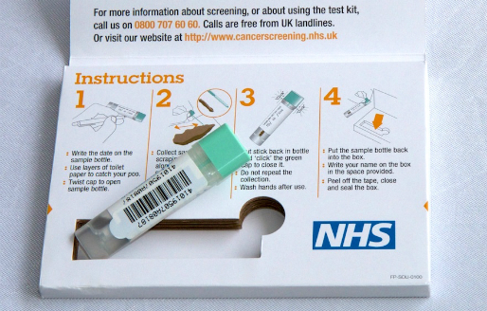
FIT Test
Faecal Immunochemical Test (FIT)
Notes:
THIS SLIDE IS FOR ENGLAND, WALES AND NORTHERN IRELAND ONLY
Aim of slide: To introduce the FIT test to your audience
Key points
The FIT test is similar to FOBt in that it detects traces of blood in poo
It has several advantages over FOBt:
Results can be measured more reliably by machine
Can be sensitive to a much smaller amount of blood – though it is likely to be introduced at roughly the same sensitivity as FOBt
Only one sample needed (FOBt needs 6, 2 from 3 poos)
A UK trial of FIT in 2014 showed a big impact on uptake, with a 7% absolute increase overall. It also showed increased uptake in groups with especially low participation rates, such as men, and people living in more deprived areas.
It is important that people in all UK countries continue to complete their FOBt kits and do not wait to be sent a FIT kit, as FIT will not be rolled out straight away
Discussion prompt
You might want to ask your audience whether they’ve heard of the FIT test
Extra information
England introducing FIT in Spring 2018
Scotland introducing FIT in Nov 2017
Wales still discussing timetable for introduction
NI considering introduction of FIT at the moment
PHE aren’t widely publicising the switch date so that people receiving FOBt still complete their kit and don’t wait for FIT
You can read about the FIT pilot here: http://gut.bmj.com/content/early/2016/06/07/gutjnl-2015-310691

Slide 5
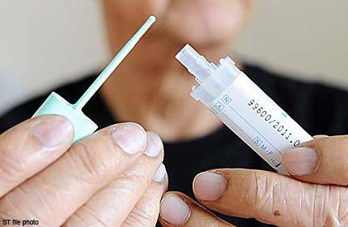
What is FIT?
What is FIT?
It is NOT a test to find cancer
It is a test to detect and quantify the amount of human blood in stool samples
An abnormal result suggests that there may be bleeding within the gastrointestinal tract that requires further investigation
Those with an abnormal result are then invited for further testing via a colonoscopy
Notes:
THIS SLIDE IS FOR ENGLAND, WALES AND NORTHERN IRELAND ONLY
Aim of slide: To introduce the FIT test to your audience
Key points
The FIT test is similar to FOBt in that it detects traces of blood in poo
It has several advantages over FOBt:
Results can be measured more reliably by machine
Can be sensitive to a much smaller amount of blood – though it is likely to be introduced at roughly the same sensitivity as FOBt
Only one sample needed (FOBt needs 6, 2 from 3 poos)
A UK trial of FIT in 2014 showed a big impact on uptake, with a 7% absolute increase overall. It also showed increased uptake in groups with especially low participation rates, such as men, and people living in more deprived areas.
It is important that people in all UK countries continue to complete their FOBt kits and do not wait to be sent a FIT kit, as FIT will not be rolled out straight away
Discussion prompt
You might want to ask your audience whether they’ve heard of the FIT test
Extra information
England introducing FIT in Spring 2018
Scotland introducing FIT in Nov 2017
Wales still discussing timetable for introduction
NI considering introduction of FIT at the moment
PHE aren’t widely publicising the switch date so that people receiving FOBt still complete their kit and don’t wait for FIT
You can read about the FIT pilot here: http://gut.bmj.com/content/early/2016/06/07/gutjnl-2015-310691

Slide 6
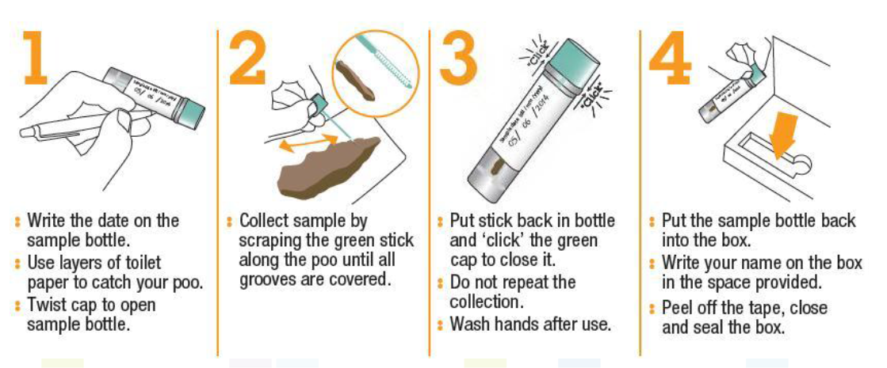
FIT: Practical Tips
Only 1 poo sample is needed
How to complete the bowel screening test animation: https://www.youtube.com/watch?v=il6VSceMWfM
Notes:
Only one test – seen a 7% increase in uptake
Key points:
6 poo samples are needed within roughly a 10 day period from 3 separate bowel motions (needs to be at the lab within 14 days of the first sample being taken)
Some people have difficulties completing the test. Here are some suggestions for collecting a sample.
CRUK have produced an animation video and factsheet with advice on completing an FOBt.
Discussion prompts
You could ask your audience whether they have any other practical ideas for helping people complete the test
You might want to show the bowel screening test animation video to your audience. The video can be accessed here: https://www.youtube.com/watch?v=m2f-wY0C_1Q
You could hand out the CRUK factsheet with advice on completing an FOBt (factsheet can be downloaded here: http://publications.cancerresearchuk.org/cancertype/bowel/howtodoabowelscreeningtest.html)
Extra information:
The sample cannot be contaminated with toilet water

Slide 7
FIT
Men and women aged between 60-74 are invited every 2 years. (The eligible population for bowel screening will change to 50-74 years over the next 4 year period due to age extension within the bowel screening programme)
Must be registered with a GP practice to receive invitation
Anyone over 74 can request a kit by calling 0800 707 6060
Screening kit is completed at home and sent to the hub
The screening hub analyses the kit
The test detects tiny amounts of blood in the sample of poo, which can’t be seen by the eye
The FIT does not diagnose bowel cancer
Notes:
Aim of this slide: To give advice on completing the test
Key points:
6 poo samples are needed within roughly a 10 day period from 3 separate bowel motions (needs to be at the lab within 14 days of the first sample being taken)
Some people have difficulties completing the test. Here are some suggestions for collecting a sample.
CRUK have produced an animation video and factsheet with advice on completing an FOBt.
Discussion prompts
You could ask your audience whether they have any other practical ideas for helping people complete the test
You might want to show the bowel screening test animation video to your audience. The video can be accessed here: https://www.youtube.com/watch?v=m2f-wY0C_1Q
You could hand out the CRUK factsheet with advice on completing an FOBt (factsheet can be downloaded here: http://publications.cancerresearchuk.org/cancertype/bowel/howtodoabowelscreeningtest.html)
Extra information:
The sample cannot be contaminated with toilet water

Slide 8
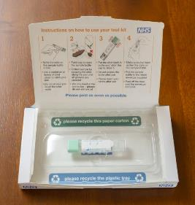
FIT: Possible Outcomes
The hub/centre/laboratory tests the kit to see whether there are any traces of blood
There are 3 potential outcomes:
No blood detected (normal result) – person receives letter informing them no further action is needed
Result is unclear – test needs to be repeated (programme sends individual a second kit)
Blood is detected (abnormal result) – The patient will have an appointment with a specialist nurse to discuss and arrange a colonoscopy
For every 100 people screened with FIT, 2 will have an abnormal result
Notes:
Aim of this slide: To give advice on completing the test
Key points:
6 poo samples are needed within roughly a 10 day period from 3 separate bowel motions (needs to be at the lab within 14 days of the first sample being taken)
Some people have difficulties completing the test. Here are some suggestions for collecting a sample.
CRUK have produced an animation video and factsheet with advice on completing an FOBt.
Discussion prompts
You could ask your audience whether they have any other practical ideas for helping people complete the test
You might want to show the bowel screening test animation video to your audience. The video can be accessed here: https://www.youtube.com/watch?v=m2f-wY0C_1Q
You could hand out the CRUK factsheet with advice on completing an FOBt (factsheet can be downloaded here: http://publications.cancerresearchuk.org/cancertype/bowel/howtodoabowelscreeningtest.html)
Extra information:
The sample cannot be contaminated with toilet water

Slide 9
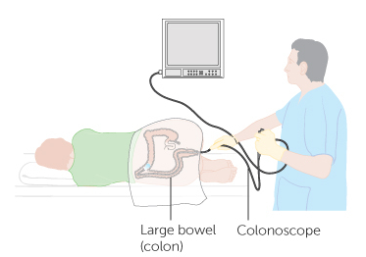
Colonoscopy
HAVING A COLONOSCOPY FOLLOWING AN ABNORMAL FIT
The colonoscopy looks at the inside of the large bowel
For every 100 people having a colonoscopy following an abnormal FIT:
50 have nothing abnormal detected
40 have polyps
10 have cancer
Notes:
Aim of this slide: To explain what a colonoscopy is and what the outcomes can be
Key points:
Colonoscopy is usually recommended for people with an abnormal FOBt result
Before a colonoscopy patients will have an appointment with a specialist nurse to talk through the procedure and determine whether they are fit to take part
The colonoscopy usually takes place in the endoscopy unit of a hospital
During a colonoscopy a flexible tube with a camera is inserted into the bowel
The endoscopist will let the person know if they had to take any biopsies or remove polyps.
If biopsies are taken, they may need to wait up to 3 weeks to get the results.
Patients will be sent a letter explaining the results of their colonoscopy and their GP will also get the results.
If cancer is found, the patient will be given an appointment to see a specialist as soon as possible
For every 100 people having a colonoscopy:
50 have neither cancer nor polyps
40 have polyps
10 have cancer
Adaptations
You may feel this slide is less relevant for certain audiences eg. pharmacists.
Extra information:
The statistics on the slide are quoted in the English and Scottish official leaflets. They are from England and come from the Logan et al paper, published in 2012 http://gut.bmj.com/content/61/10/1439 )
The test itself takes about 30 minutes, but the whole appointment can take up to 4 hours.
People can be sedated if they wish or have painkillers
There is a CRUK video ‘having a colonoscopy’, available here: https://www.youtube.com/watch?v=Q7FWQ7cy8kQ

