Slide 1


SYB Cervical Screening Behavioural Science Programme Introduction for Primary Care
Tracey Turner
SYB ICS Cancer Alliance
Inequalities and Early Diagnosis Project Manager

Slide 2



Behavioural Science Concept
DEFINITION
The study of “human habits, actions and intentions” spanning the fields of psychology, service improvement, data analytics and organisational behaviour.
WHAT IS A ’NUDGE’?
A technique to encourage people to make different choices (usually for their benefit or greater society) without reducing choices available.
2

Slide 3
Concepts We Use To Develop Nudges
In order to develop ‘Nudges’ to influence how people interact with services we use a number of concepts based on how humans think and behave:
1
4
1
‘Type 2 Thinking’. – We use consideration and judgement when deciding what they want to do
‘Type 1 Thinking’. - We make quicker and more automatic decisions based on what is presented to them
Key Concepts
Type 1 & 2 Thinking
Cognitive Biases
Value Modes
COM-B
Understand barriers through:
Defining the Behaviour to Change
Understanding:
  Capability
  Opportunity
  Motivation
4
2
3
Settlers – Like top-down messages and likely to follow the majority.
Prospectors - Guided by external influences & want be part of the ‘in crowd’
Pioneers – Strong sense of right & wrong and social purpose.
2
Shortcuts that our brains take when making decisions. Most of the conscious decisions we make are being made with filtered data or a heavily biased mindset
3
3

Slide 4
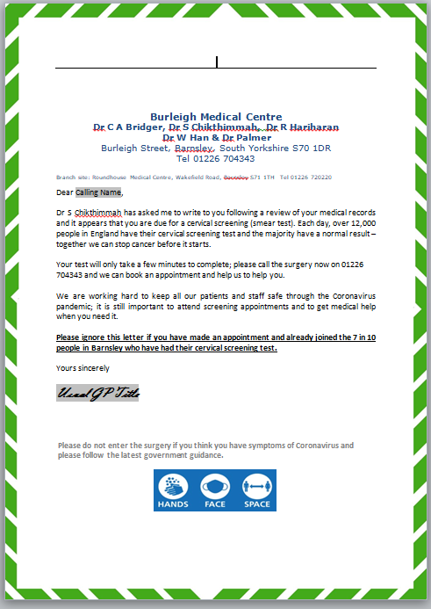
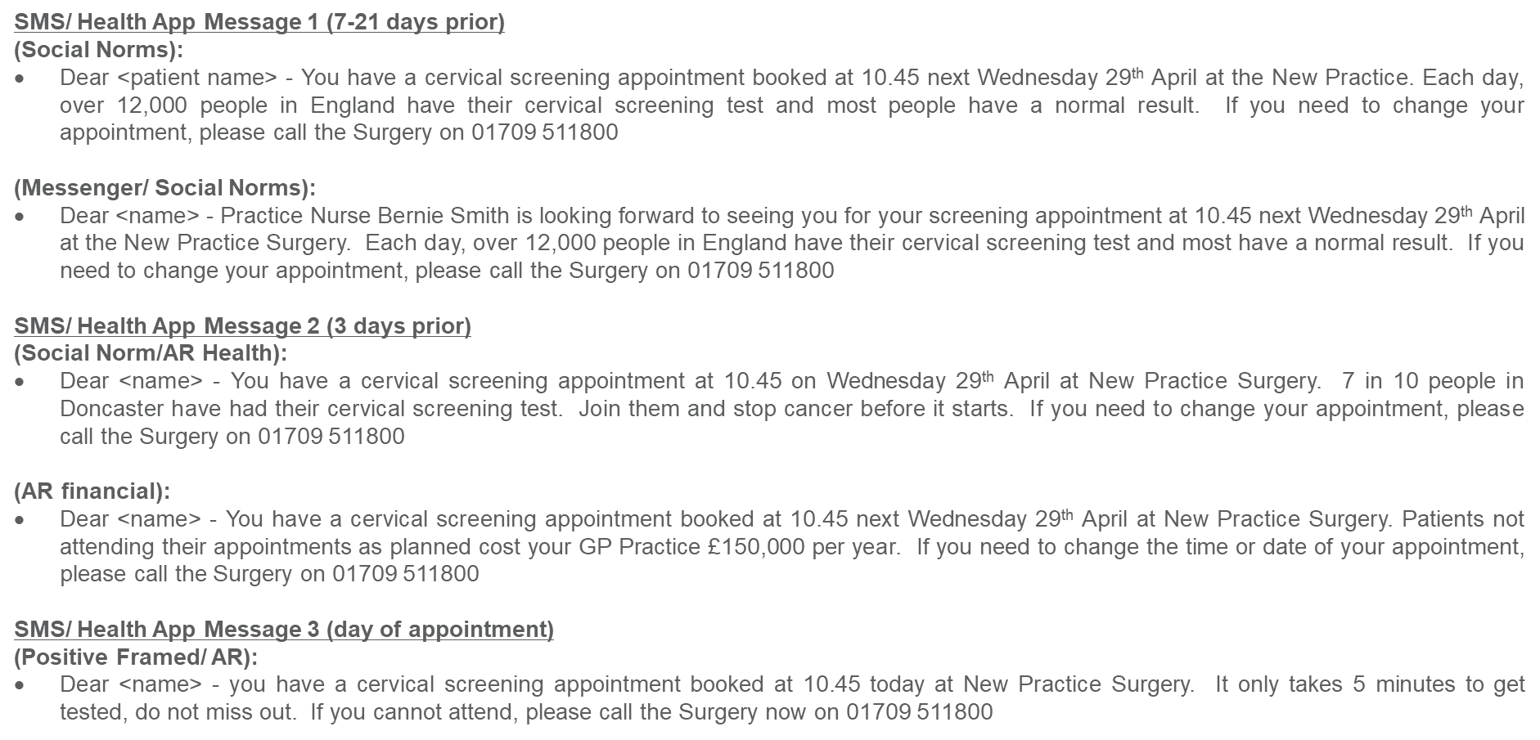
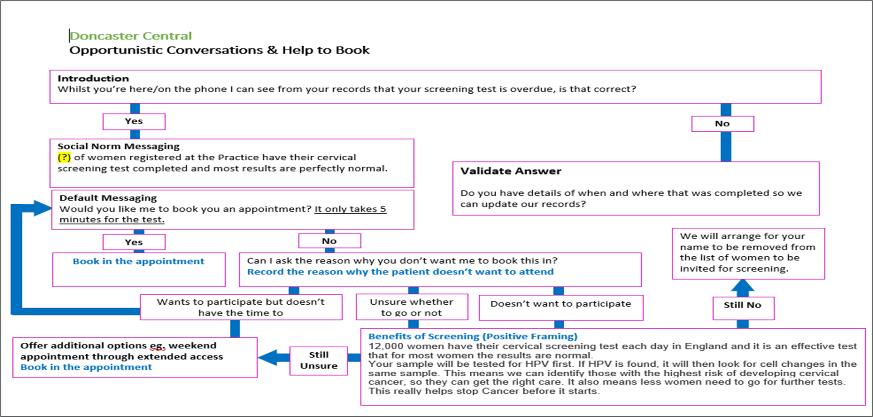
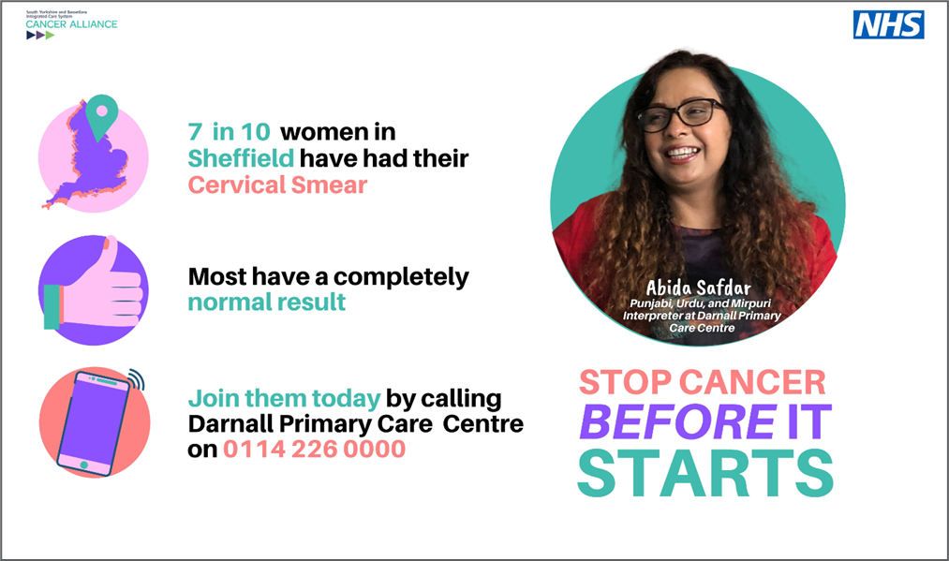
Interventions
Non-Responder Follow up letter (English, Urdu, Bengali, Polish, Slovak, Romanian)
Easy Read leaflet (English, Urdu, Bengali, Polish, Slovak, Romanian)
SMS reminder messages
Opportunistic Script
Proactive Script
Video Trial
Drop in Clinic
Notes:
So all that theory then informed the nudge interventions to support the processes already taking place in practices:
Complete rewrite of practices non responder letters and SMS text messages and reminders
Practice training in Behavioural science and implementation of Opportunistic and proactive scripts
Communication assets/resources developed with practice and community leaders
Video production with a sample taker.
All the assets have a common golden thread as evidence shows if you layer the nudge interventions you have a greater impact

Slide 5
Programme Process Steps & Interventions
Behavioral Science Basic training and introduction to the interventions training delivered to Primary care team both clinical and non clinical - 1 x session F2F or over MS teams (1¼ Hour session).
Practice/PCN working group including PM, GP, PN, Admin, Reception.
Insight meeting to understand PCN/Practice challenge and discuss interventions (F2F or Virtual 1 hour).
Go Live date for interventions meeting (45 mins)
Interventions agreed and adapted to reflect practice processes and patient demographic.
Non-Responder Letters
Easy Read Leaflet
SMS Appointment Reminders
Scripted Conversations
  Opportunistic Help to Book
  Pro-active Help to Book
Drop in clinic resources
COVID Nudge
Social Media Messages
Video
UK Population:
20% Settlers
40% Prospectors
40% Pioneers

Slide 6

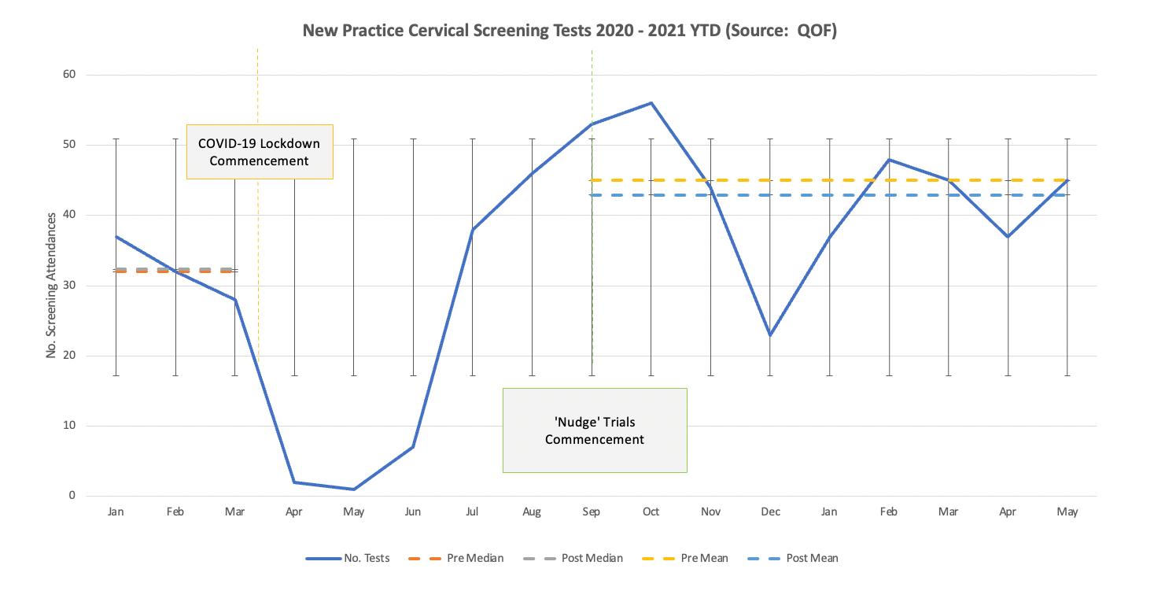
Cervical Screening Results
12 MONTH IMPACT ASSESSMENT; HIGHLIGHTS FROM NEW SURGERY, MEXBOROUGH
Outcome:
Median based difference = Increase 139 samples taken (27%), Mean based difference = Increase 85.82 samples taken (19%)
Circa 5 – 7 additional women referred for further diagnostic activity.
The practice previously had reasonable performance and hit QOF Targets; however, that traditionally took considerable effort to achieve.
The practice staff anecdotally report an increase in people attending screening (which is validated in the data) and report people attending screening who previously delayed or avoided engaging with the practice in relation to the screening programme.
Interventions have been easy to implement and have provided consistency of approach and message across all practice staff.
Trials commenced September 2020
4 Nudge Toolkits implemented:
  Pro-active help to book – semi-scripted conversation
  Opportunistic help to book -semi scripted conversation
  Non-Responder Letter
  SMS Appointment Reminder - Loss Aversion message
Demographic Information
Predominantly a white British Population (over 95%)
51% female & 49% male
Area of high deprivation. Some ward in top decile/10%
Data Variations
Categorisation of samples changed in xx so no further historic data is available.
COVID pandemic halted sample taking from xx – xx
December data reflects 3 weeks not 4 week sample taking due to Christmas break
Pre-Intervention Monthly Mean: 32.33
Post-Intervention Monthly Mean: 42.91 (+10.58)
Pre-Intervention Monthly Median: 32.00
Post-Intervention Monthly Median: 45.00 (+2.09)
Summary Evaluation Paper with full details attached

Slide 7

Early Adopter Practices Testomony
New Surgery were fortunate to be invited to participate in a pilot scheme to improve our cervical cytology uptake rates. It has been a total team approach working alongside the expertise of Cancer Alliance and Caja on the Behavioural Science Programme.
The training/guidance has been very supportive and engaging. It has been eye opening experience into the world of behavioural science which has empowered us all to carry this into all different parts of our work (and lives). We have greatly benefitted from the support from the Cancer Alliance [Tracey] and Caja [Nigel -BSP] and enjoyed every moment of the journey with them and the very positive results we have gained. An experience we recommend to all practices.
UK Population:
20% Settlers
40% Prospectors
40% Pioneers
Nudge the Odds testimonials - YouTube
Lots of Soft Benefits!!

